Slide 1


Eduard Tiron
15-02-2023

Slide 2

Table of Contents
Executive Summary
Introduction
Methodology
Results
Conclusion
Appendix

Slide 3
Executive Summary
Summary of methodologies:
Data collection: API, Web Scraping
Data Wrangling, Exploratory Data Analysis (EDA) with Data Visualization
EDA with SQL
Interactive Map with Folium
Dashboards with Plotly Dash
Predictive Analysis
Summary of all results:
Exploratory Data Analysis results
Interactive maps and dashboard
Predictive results

Slide 4
Introduction
In this project we take the role of a rocket launching company, Space Y, trying to compete with space X.
We need to predict the success of the second stage recovery in order to reduce costs.
We need to find the best launching location to increase the probability of a successful second stage recovery.

Slide 5
Introduction
Throughout the report, we refer to launches as successful (class 1) or unsuccessful (class 0). This merely refers to whether or not the 2nd stage was recovered for later reuse, but has no bearing on the actual mission of sending the payload to space.

Slide 6

Section 1

Slide 7
Methodology
Executive Summary
Data collection methodology:
SpaceX API
Wikipedia (Webscraping): “List of Falcon 9 and Falcon Heavy launches”
Performed data wrangling
Cleaned data.
Created a landing outcome label based on outcome data after summarizing and analyzing features.

Slide 8
Methodology
Executive Summary
Performed EDA using Python visualization libraries and SQL
Performed interactive visual analytics with Folium and Plotly Dash
Performed predictive analysis using many classification models
Selected best model based on prediction score on the testing set.
Found optimal parameters of each model with with GridSearchCV.

Slide 9
Data Collection – SpaceX API
Request API and
parse the SpaceX
launch data
SpaceX offers a public API from where data about past launches can be requested for free.
Click here to see the relevant Jupyter notebook hosted on GitHub.
Filter data to only
include Falcon 9
launches
Deal with missing
values

Slide 10
Data Collection - Webscraping
Download the Falcon 9 Wikipedia page
Data from past launches is also publically available on Wikipedia.
It is presented in tables intended for human reading, but we can extract the data with Python’s library BeautifulSoup.
Click here to see the relevant Jupyter notebook hosted on GitHub.
Parse the html to identify the tables with data about past lauches
Extact the relevant data

Slide 11
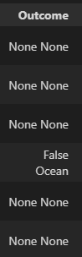
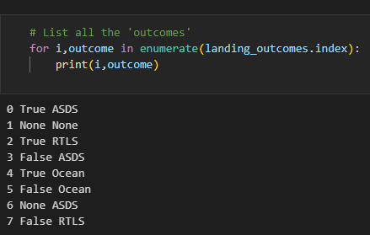
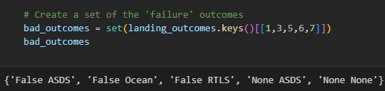
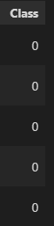
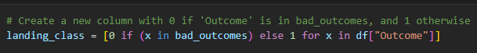
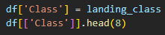
Data Wrangling
In the raw dataset, the ‘success’ value is mixed with other information:
• True Ocean, True RTLS, True ASDS means the mission was successful.
• False Ocean, False RTLS, False ASDS means the mission was a failure.
We need to extract the True/False string into a categorical variables where 1 means the mission has been successful and 0 means the mission was a failure.
Click here to see the code.

Slide 12
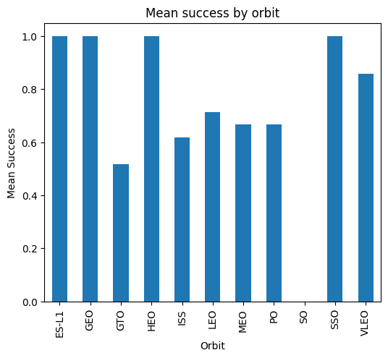
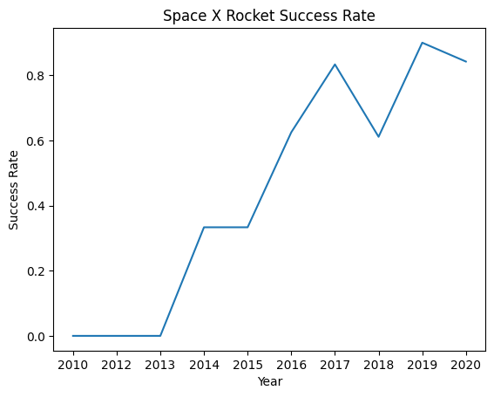
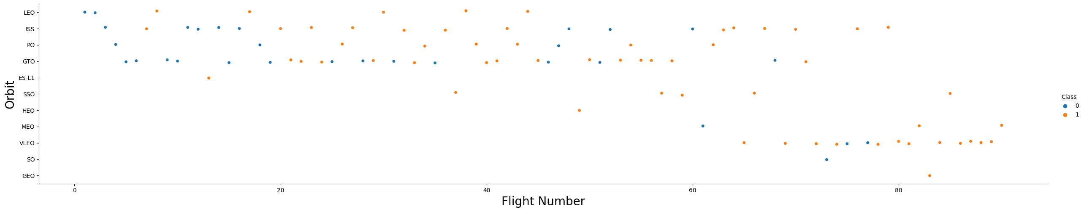
EDA with Data Visualization
Scatter Graphs
(shows relationship between variables to infer correlations)
• Flight Number vs. Payload Mass
• Flight Number vs. Launch Site
• Payload vs. Launch Site
• Orbit vs. Flight Number
• Payload vs. Orbit Type
• Orbit vs. Payload Mass
Bar Graph
(shows the relationship between numeric and categoric variables)
• Success rate vs. Orbit
Line Graph
(shows trends)
• Success rate vs. Year
Click here to
see the code.

Slide 13
EDA with SQL
Performed SQL queries:
• Display the names of the unique launch sites in the space mission.
• Display 5 records where launch sites begin with the string ‘CCA'.
• Display the total payload mass carried by boosters launched by NASA (CRS).
• Display average payload mass carried by booster version F9 v1.1.
• List the date when the first successful landing outcome in ground pad was achieved.
• List the names of the boosters which have success in drone ship and have payload mass greater than 4000 but less than 6000.
• List the total number of successful and failure mission outcomes.
• List the names of the booster versions which have carried the maximum payload mass.
• List the failed landing outcomes in drone ship, their booster versions and launch site names for the months in year 2015.
• Rank the count of landing outcomes (such as Failure at drone ship or Success at ground pad) between the date 2010-06-04 and 2017-03-20 in descending order.
Click here to
see the code.

Slide 14
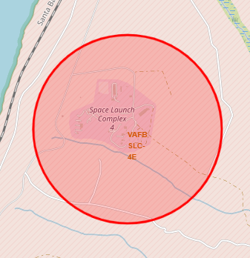
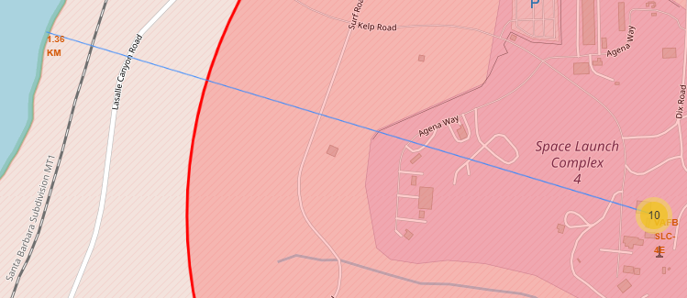
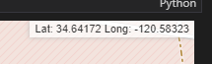
Build an Interactive Map with Folium
Graphical entities used with Folium Maps:
Markers indicate points like launch sites.
Circles indicate highlighted areas around specific coordinates, like NASA Johnson Space Center.
Marker clusters indicates groups of events in each coordinate, like launches in a launch site.
Mouse position is used to show the coordinates of the location under the cursor.
Lines and small numeric labels are used to indicate distances between two points.
Click here to
see the code.

Slide 15
Build a Dashboard with Plotly Dash
The final dashboard has the following components:
• Dropdown: allows a user to select a launch site (or all of them).
• Pie chart: shows the total success and the total failure for the selected launch site.
• Rangeslider: allows a user to select a payload mass in a fixed range.
• Scatter chart: shows the relationship between two variables, in particular Success vs Payload Mass.
Click here to
see the code.

Slide 16
Predictive Analysis (Classification)
Data preparation and standarization
Split data into train and test sets
Classification models used:
Logistic Regression
Support Vector Machine
Decision Tree Classifier
K-Nearest Neighbors
Initialize a model in one of the classification algorithms
Prepare a GridSearchCV to find optimal model parameters
Click here to
see the code.
Test the model on the test data and get its score
Train the model
Select the model with the best score

Slide 17
Results
Exploratory data analysis results:
• Space X uses 4 different launch sites.
• The first launches were done to Space X itself and NASA.
• The average payload of F9 v1.1 booster is 2,928 kg.
• The first success landing outcome happened in 2015 fiver year after the first launch.
• Many Falcon 9 booster versions were successful at landing in drone ships having payload above the average.
• Almost 100% of mission outcomes were successful.
• Two booster versions failed at landing in drone ships in 2015: F9 v1.1 B1012 and F9 v1.1 B1015.
• The ratio of successful landing outcomes increased as years passed.

Slide 18
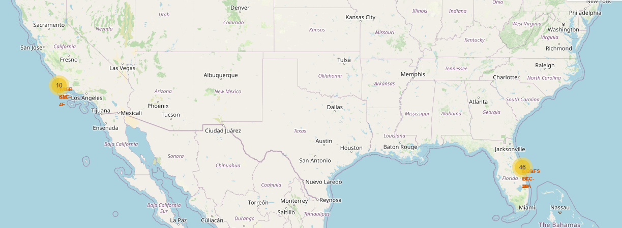
Results
Interactive mapping revealed that launch sites are usually in safe places away from population and near the sea.
They also have good logistic infrastructure around.
Most launches happens at east cost launch sites.

Slide 19
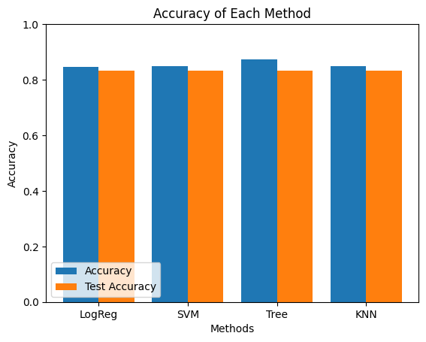
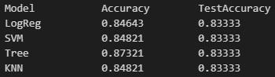
Results
Predictive Analysis showed that Decision Tree Classifier is the best model to predict successful landings, having accuracy of approximately 87%, and a similar test accuracy to other models.

Slide 20

Section 2

Slide 21
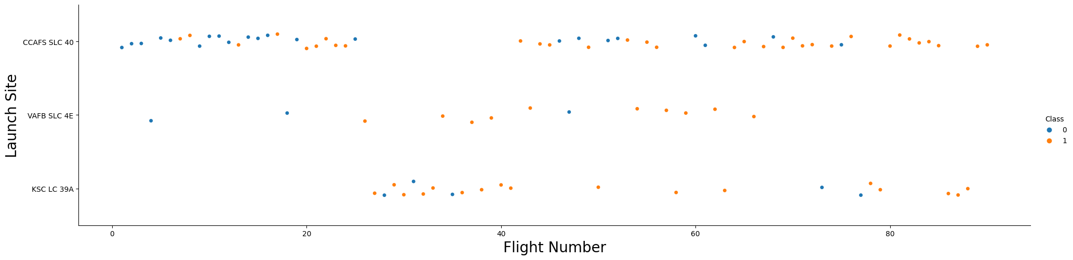
Flight Number vs. Launch Site
The best launch site nowadays is CCAF5 SLC 40, where most of recent launches were successful.
In second place there’s VAFB SLC 4E, and in third place KSC LC 39A.
The general success rate has improved over time for all sites.

Slide 22
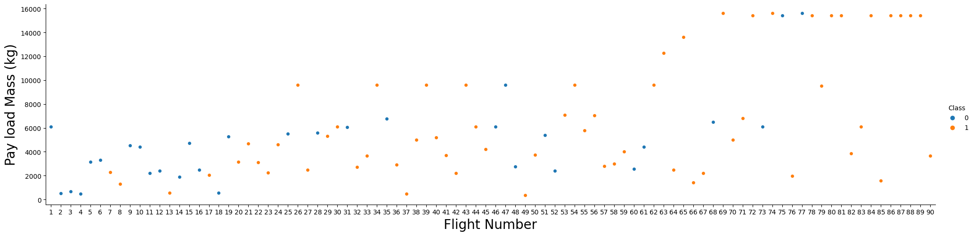
Payload vs. Launch Site
Payloads over 9,000kg (about the weight of a school bus) have excellent success rate.
Payloads over 12,000kg seems to be possible only on CCAFS SLC 40 and KSC LC 39A launch sites.

Slide 23
Success Rate vs. Orbit Type
The biggest success rates (100%) happens when lauching to orbits:
ES-L1
GEO
HEO
SSO
Followed closely by:
VLEO (above 80%)
Note that a high success rate might be due to luck if the orbit has been used only a handful of times.

Slide 24
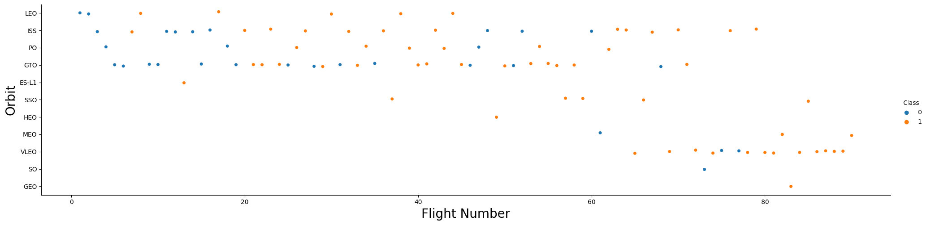
Flight Number vs. Orbit Type
Observations:
Success rate improved over time regardless of the orbit.
VLEO orbit seems a new business opportunity. We saw that it had a lowers success rate than others (80% vs 100%) but it has had many more attempts.

Slide 25
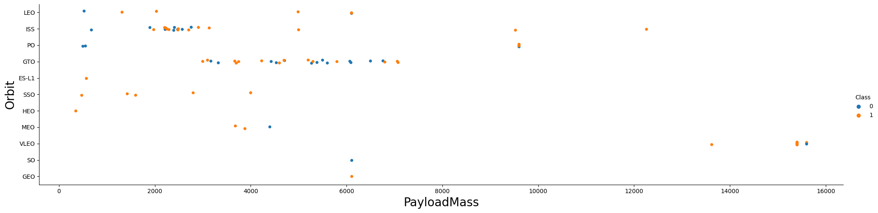
Payload vs. Orbit Type
Observations:
There is no significant relationship between payload and success rate to orbit GTO.
ISS orbit has the widest range of payload and a good rate of success.
There are very few launches to the orbits SO and GEO, and of a significantly high payload.

Slide 26
Launch Success Yearly Trend
Observations:
Success rate started increasing in 2013 and kept rising until 2020 (with a dip in 2018).
It seems that the first three years were a period of experimentation of the technology in its infancy.

Slide 27
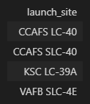
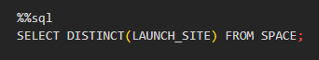
All Launch Site Names
This query returned a list of all used launch sites:

Slide 28
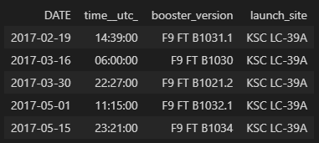
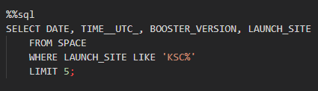
Launch Site Names Begin with 'KSC'
This query found 5 records where launch sites begin with `KSC`:

Slide 29
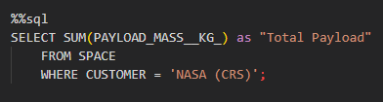
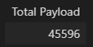
Total Payload Mass
This query calculated the total payload carried by boosters from NASA:

Slide 30
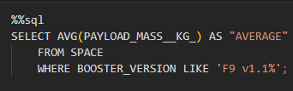
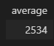
Average Payload Mass by F9 v1.1
This query calculates the average payload mass carried by booster version F9 v1.1:

Slide 31
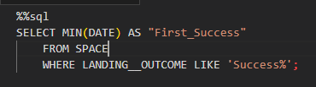
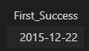
First Successful Ground Landing Date
This query finds the dates of the first successful landing outcome on ground pad:

Slide 32
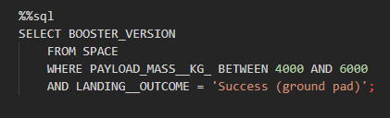
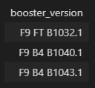
Successful Drone Ship Landing with Payload between 4000 and 6000
This query lists the names of boosters which have successfully landed on drone ship and had payload mass greater than 4000 but less than 6000:

Slide 33
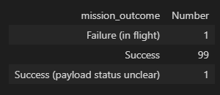
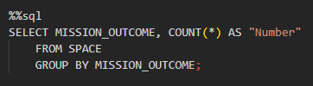
Total Number of Successful and Failure Mission Outcomes
This query calculates the total number of successful and failure mission outcomes:

Slide 34
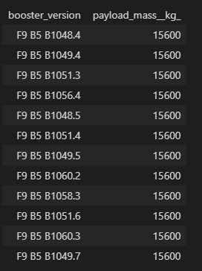
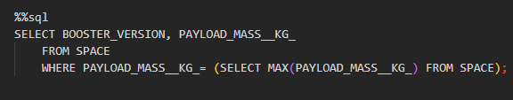
Boosters Carried Maximum Payload
This query lists the names of the boosters which have carried the maximum payload mass:

Slide 35
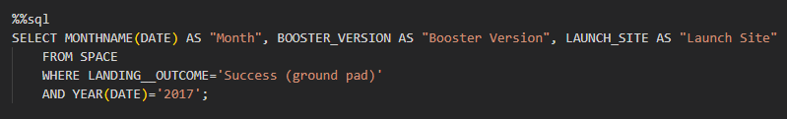
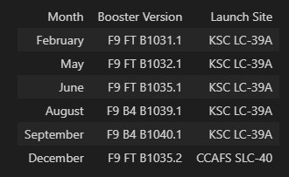
2017 Successful Launch Records
This query lists the failed landing_outcomes in drone ship, their booster versions, and launch site names for the year 2017:

Slide 36
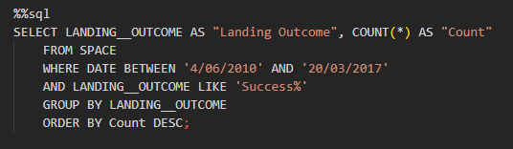
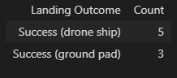
Rank Landing Outcomes Between 2010-06-04 and 2017-03-20
This query ranks the count of landing outcomes (such as Failure (drone ship) or Success (ground pad)) between the dates 2010-06-04 and 2017-03-20, in descending order:

Slide 37

Section 3

Slide 38
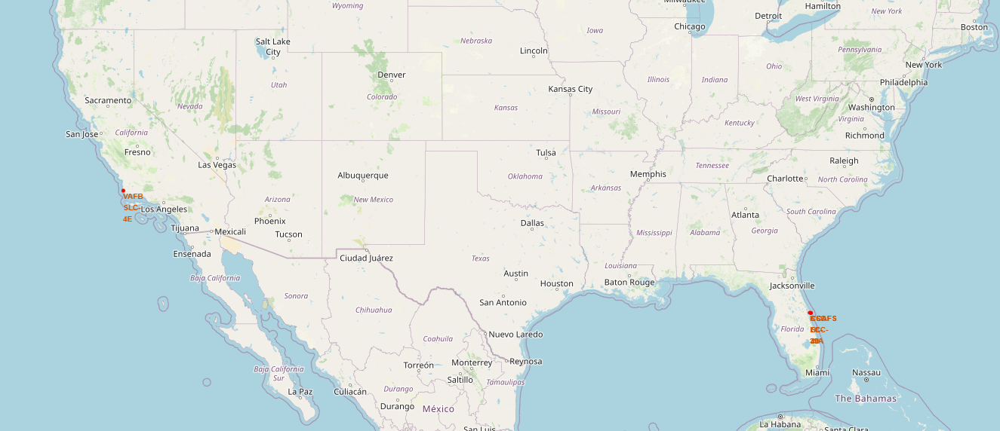
All launch locations
The following map shows the launch locations used by SpaceX. They are always next to the ocean.

Slide 39
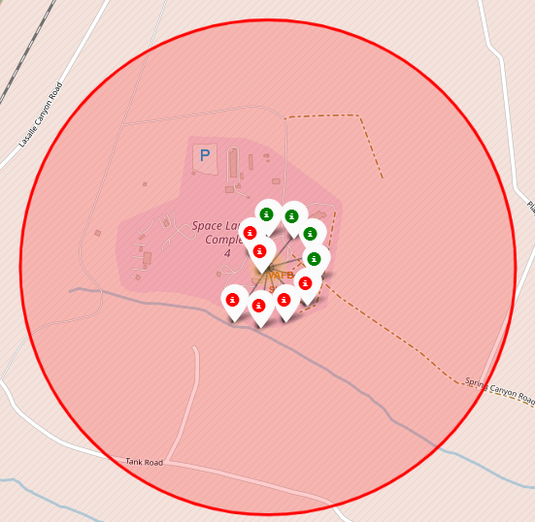
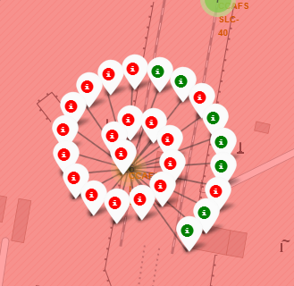
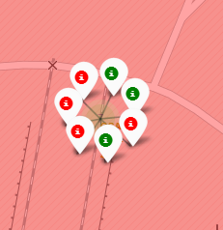
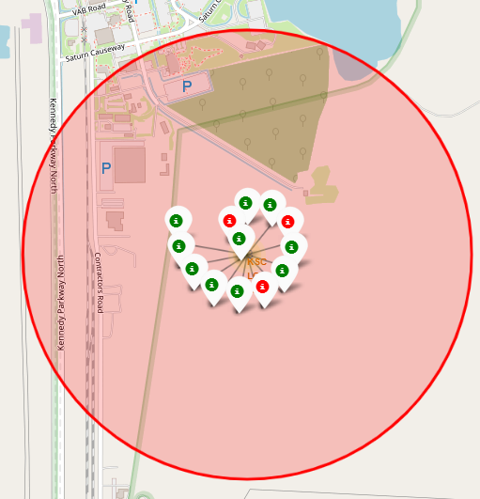
Launch outcomes by location
These are the color-labeled launch outcomes on each location (green for success, red for failure).
CCAFS SLC-40
VAFB SLC-4E
KSC LC-39A
CCAFS LC-40

Slide 40
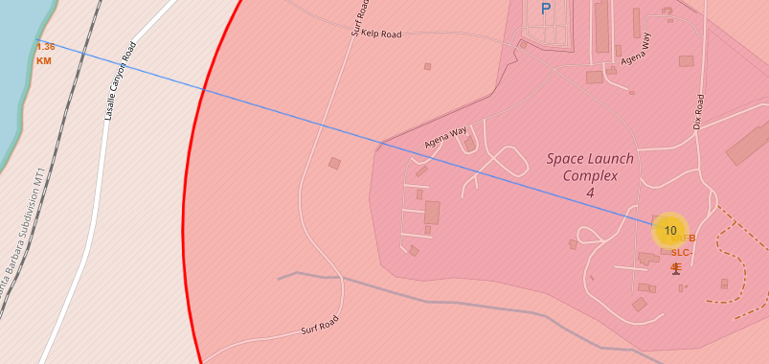
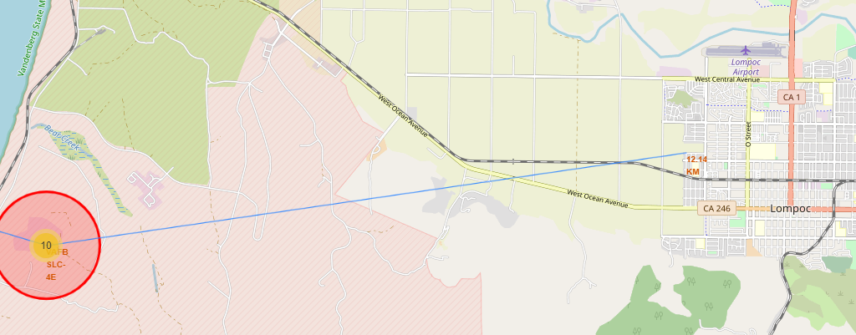
Launch site surroundings
These screenshots show a launch site located close to the ocean and far from the nearest city, for safety of the population. Railroads are also relatively close for logistics. This pattern is true for all launch sites.

Slide 41

Section 4

Slide 42
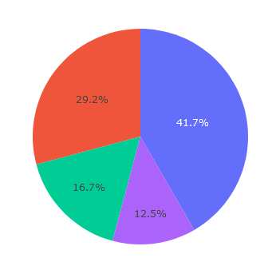
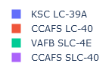
Successful launch percentage for every site
This piechart shows how all the successful launches are distributed among the different launch sites.

Slide 43
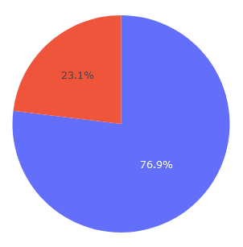
Launch success ratio for site KSC LC-39A
KSC LC-39A is the site with the highest successful launch ratio.
Success
Failure

Slide 44
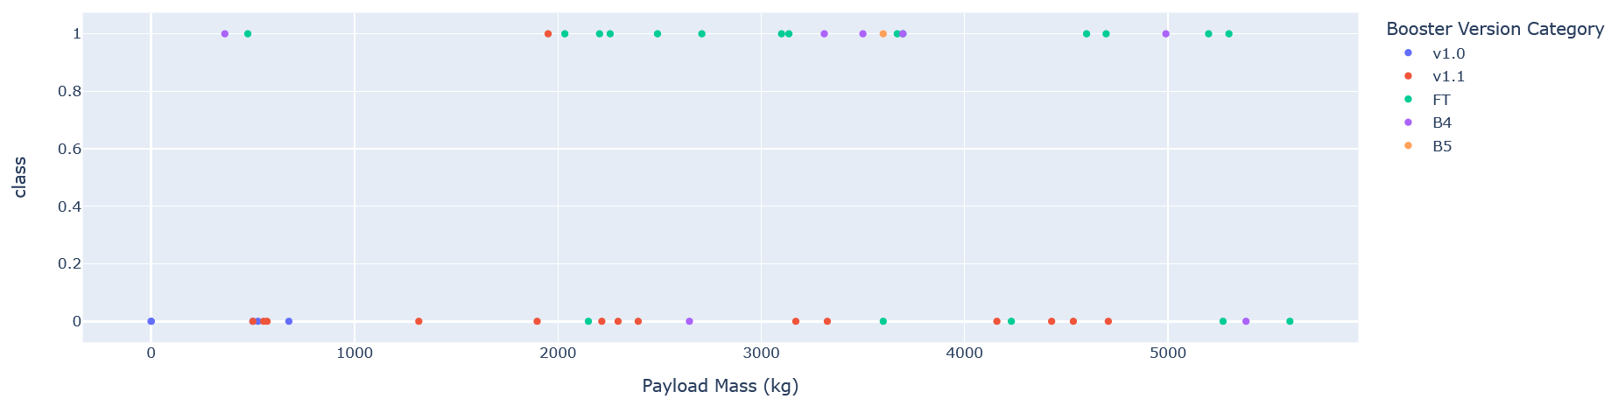
Payload Mass vs Launch Outcome (small loads)
This scatter plot shows Payload vs. Launch Outcome for all sites, with payloads up to 6000 kg.
At these loads, FT is the most reliable booster version.

Slide 45

Payload Mass vs Launch Outcome (large loads)
This scatter plot shows Payload vs. Launch Outcome for all sites, with payloads from 6000 kg to 10000 kg.
At these loads, there is a low chance of success. Only the B4 booster has achieved one successful launch.

Slide 46

Section 5

Slide 47
Classification Accuracy
Four classification models were built and optimized:
Logistic regression
SVM
Tree classifier
K-Nearest neighbors
For accuracy on the test set, all methods performed similar. We could repeat the model creation with different random training and testing sets, but if we really need to choose one right now, we would take the decision tree (87% accuracy in training).

Slide 48

Confusion Matrix
All the confusion matrices of each model were the same. They all predict negatives well but have a problematic number of false positives.

Slide 49
Conclusions
The best launch site is KSC LC-39A.
The success of a mission can be explained by several factors such as the launch site, the orbit and especially the number of previous launches.
Successful landing outcomes seem to improve over time. We can assume that there has been a gain in knowledge between launches that allowed to go from a launch failure to a success.
The orbits with the best success rates are GEO, HEO, SSO, ES-L1.
Depending on the orbits, the payload mass can be a criterion to take into account for the success of a mission. Some orbits require a light or heavy payload mass. But generally low weighted payloads perform better than the heavy weighted payloads.
All the sites are in very close proximity to the coast and logistic facilities, while being far from urban centers.
For this dataset, we choose the Decision Tree Algorithm as the best model even if the test accuracy between all the models used is identical. We choose Decision Tree Algorithm because it has a better train accuracy.

Slide 50


